Slide 1
Registration
Reference: https://www.codejava.net/frameworks/spring-boot/user-registration-and-login-tutorial

Slide 2
What we are going to do today
Match
Entity User class to match with the database table
Signup form to get user’s data
A database to store User data
Repository to save data to the database
@Autowired
Controller class to handle the data
Save
Notes:
The data get from the signup form is in the format of the User object

Slide 3
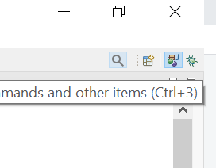
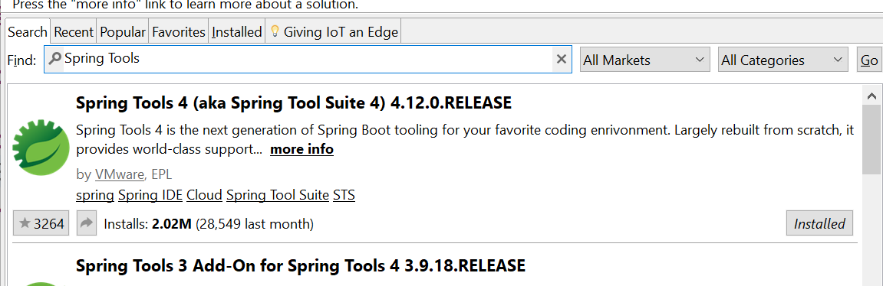
Add Spring Boot Spring Tool Suite
Click the search icon in the top-right corner
Search “Eclipse Marketplace”
Find with keyboard “Spring Tools”
Install Spring Tools 4
https://www.codejava.net/ides/eclipse/install-spring-tool-suite-for-existing-eclipse-ide

Slide 4
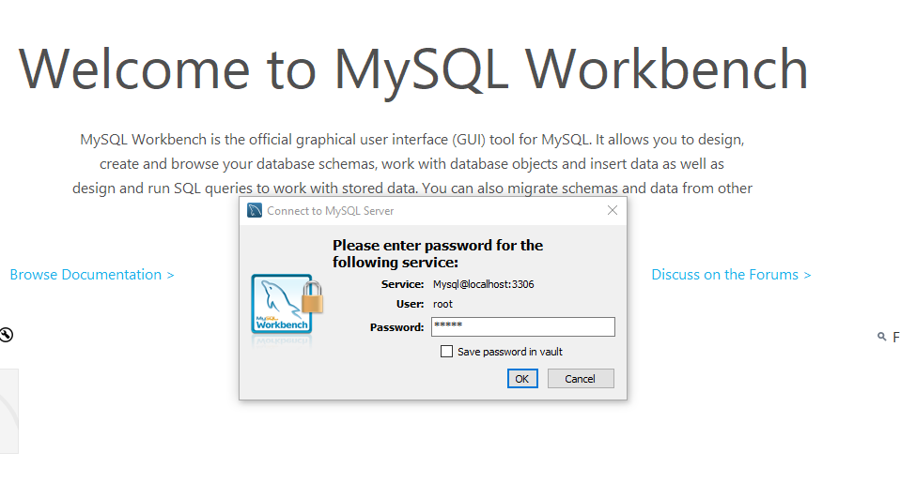
Create a database in MySQL
Click MySQL Workbench
Login with password: it353
Notes:
Try to create a user table
And add data to it

Slide 5
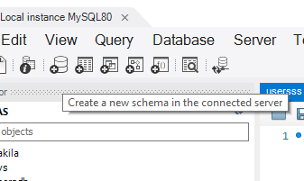
Create a new schema in the connected Server

Slide 6
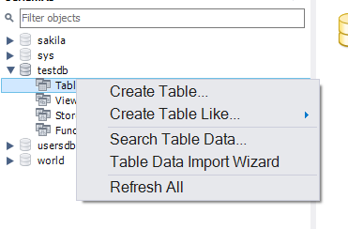
Create a table
Right click on tables -> create table
Notes:
Try to create one table

Slide 7
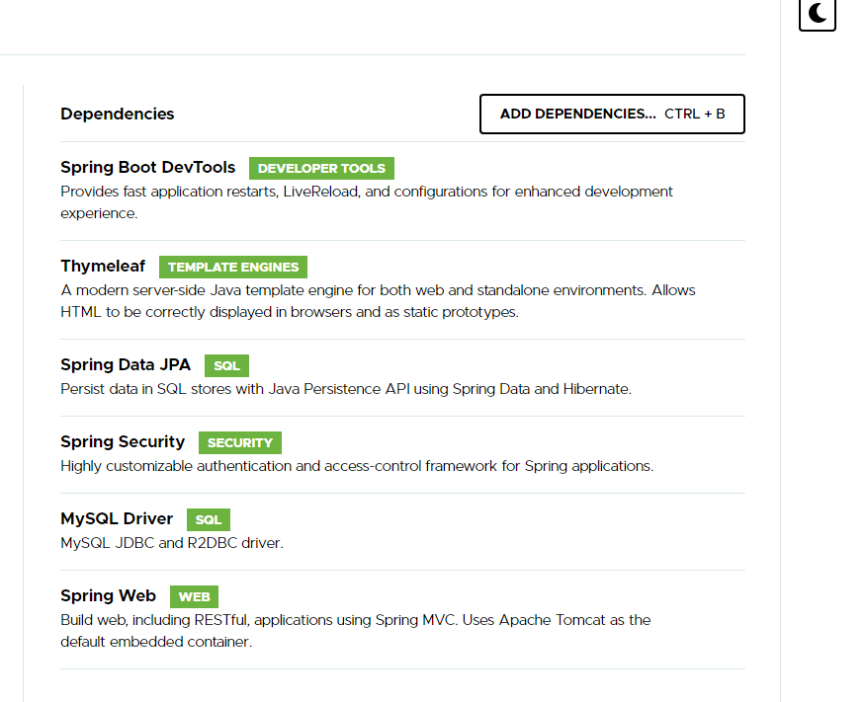
Create a project with the following dependencies

Slide 8
Add code in “application.properties” to connect to the database
spring.jpa.hibernate.ddl-auto=create
spring.datasource.url=jdbc:mysql://${MYSQL_HOST:localhost}:3306/usersdb
spring.datasource.username=root
spring.datasource.password=it353
spring.jpa.properties.hibernate.format_sql=true
The database you created
Notes:
spring.jpa.hibernate.ddl-auto=create
Will create a new table
After first run, set it to
spring.jpa.hibernate.ddl-auto=none

Slide 9
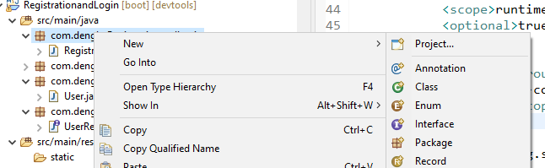
Add an entity package, then a “User” class
Goal: Create an entity class matching with the data table
Notes:
Entity class matches with database table

Slide 10
In “User” class
@Entity
@Table(name = "users") //match with the users table in the database
public class User {
@Id
@GeneratedValue(strategy = GenerationType.IDENTITY)
private Long id;
@Column(nullable = false, unique = true, length = 45)
private String email;
@Column(nullable = false, length = 64)
private String password;
@Column(name = "first_name", nullable = false, length = 20)
private String firstName;
@Column(name = "last_name", nullable = false, length = 20)
private String lastName;
}

Slide 11
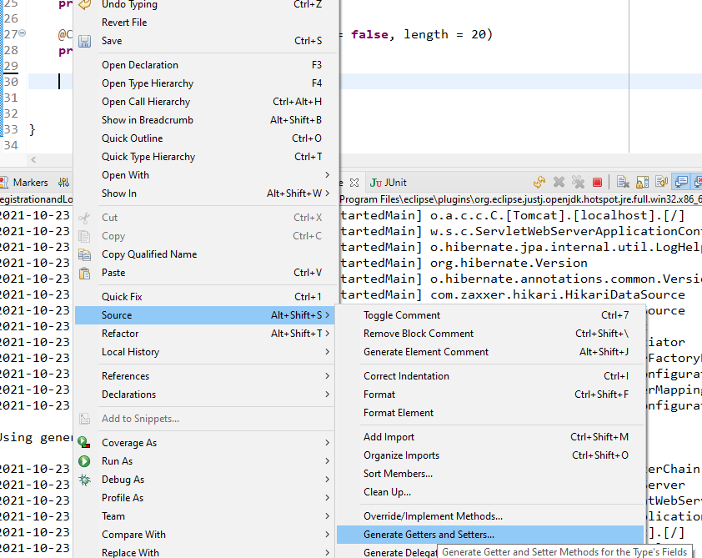
In “User” class
Right click->Source->
Generate Getters and Setters…

Slide 12
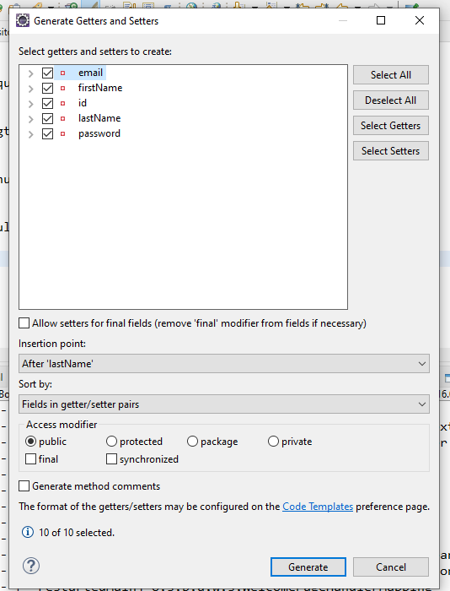
Select All-> Generate

Slide 13
Add a repository package, then a “UserRepository” interface
Goal: to save data to the database table
public interface UserRepository extends JpaRepository<User, Long> {
}
Notes:
The data are handled like User objects, and the primary key is Long

Slide 14
Add a signup page and index page in the templates folder
You can download the pages from Reggienet
Notes:
<!DOCTYPE html>
<html xmlns:th="http://www.thymeleaf.org">
<head>
<meta charset="ISO-8859-1">
<title>Sign Up - CodeJava</title>
<link href="https://cdn.jsdelivr.net/npm/bootstrap@5.1.1/dist/css/bootstrap.min.css" rel="stylesheet">
<script src="https://cdn.jsdelivr.net/npm/bootstrap@5.1.1/dist/js/bootstrap.bundle.min.js"></script>
<script src="https://ajax.googleapis.com/ajax/libs/jquery/3.5.1/jquery.min.js"></script>
</head>
<body>
<div class="container text-center">
<div>
<h1>User Registration - Sign Up</h1>
</div>
<form th:action="@{/process_register}" th:object="${user}"
method="post" style="max-width: 600px; margin: 0 auto;" >
<div class="m-3 text-center">
<div class="form-group row">
<label class="col-6 col-form-label">E-mail: </label>
<div class="col-6">
<input type="email" th:field="*{email}" class="form-control" required />
</div>
</div>
<div class="form-group row">
<label class="col-6 col-form-label">Password: </label>
<div class="col-6 ">
<input type="password" th:field="*{password}" class="form-control"
required minlength="6" maxlength="10"/>
</div>
</div>
<div class="form-group row">
<label class="col-6 col-form-label">First Name: </label>
<div class="col-6 ">
<input type="text" th:field="*{firstName}" class="form-control"
required minlength="2" maxlength="20"/>
</div>
</div>
<div class="form-group row">
<label class="col-6 col-form-label">Last Name: </label>
<div class="col-6 ">
<input type="text" th:field="*{lastName}" class="form-control"
required minlength="2" maxlength="20" />
</div>
</div>
<div>
<br>
<button type="submit" class="col-6 btn btn-primary">Sign Up</button>
</div>
</div>
</form>
</div>
</body>
</html>

Slide 15
Add a controller package, then a “AppController” class
@Controller
public class AppController {
@GetMapping("")
public String viewHomePage() {
return "index";
}
@GetMapping("/register")
public String showRegistrationForm(Model model) {
model.addAttribute("user", new User());
return "signup_form";
}
}
Notes:
Question: why need the packages? How about put all classes in one place? Will the app still work without the packages? Yes, but packages will make it much easier to find them, especially when you have many pages.

Slide 16
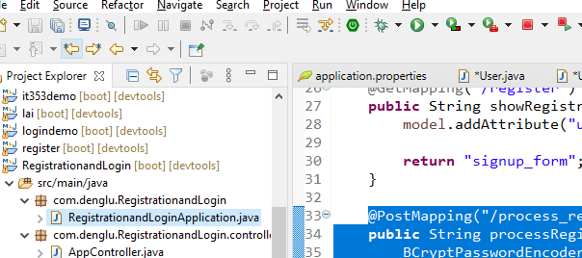
Run the application
Select the application.java class, then click
Or Select the application.java class -> right click -> run as -> Spring Boot App

Slide 17
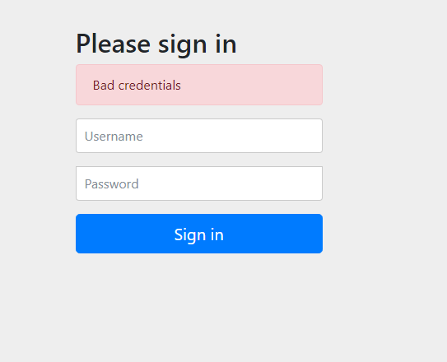
Check localhost:8080 Where did the sign in page from?
Notes:
When we add the security dependency, the sign in page will be created automatically

Slide 18
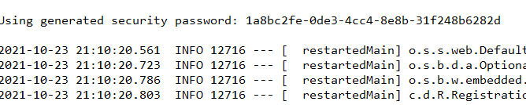
Sign in with the password in the console
The username is user
Your password should be similar to this

Slide 19
Add the PostMapping to the AppController class
<form th:action="@{/process_register}" th:object="${user}"
method="post">
@Autowired
private UserRepository userRepo;
@PostMapping("/process_register")
public String processRegister(User user) {
//how come userRepo can save data without any methods in it?
userRepo.save(user);
return "register_success";
}
They match!
Notes:
UserRepository extends JpaRepository, which has the save () method
Because it is autowired, so it the method can be used automatically

Slide 20
Thymeleaf
<form th:action="@{/process_register}" th:object="${user}"
method="post">
th:action=”@{url}” and th:object=”${object}” attributes
The th:action is used to provide the form action URL
and th:object is used to specify an object to which the submitted form data will be bound.
Individual fields are mapped using the th:field=”*{name}” attribute
Notes:
Thymeleaf is a Java template engine for processing and creating HTML, XML, JavaScript, CSS, and text.
@ --url
$--variable

Slide 21
Change in “application.properties”
Change create to none, otherwise a new table will be created each time you restart your application
spring.jpa.hibernate.ddl-auto=none
Notes:
spring.jpa.hibernate.ddl-auto=create
Change to none

Slide 22
What we did today
Match
Entity User class to match with the database table
Signup form to get user’s data
A database to store User data
Repository to save data to the database
@Autowired
Controller class to handle the data
Save
Notes:
The data get from the signup form is in the format of the User object

